Slide 1

Predicting NFL Player Outcomes through the Lens of Fantasy Football
STAT 6341: Sports Analytics
Delaney Helgeson

Slide 2
Project Goals
Prospective Modeling
Predict the Fantasy Points that a player will score in a given future game based on his past performance and game characteristics known ahead of time
Performance Indicators
Understand the factors that contribute to a player’s performance, measured in Fantasy Points
2

Slide 3

Consumers
People that participate in Fantasy Football and/or bet on professional football.
Modeling Component
Sports bettors can enter information about their player of interest into the model and receive a predicted fantasy score in return. The score can help the person decide whether to bet on the player each week.
Used on a weekly basis
Data Visualization Component
Sports bettors can explore the interactive visualizations to better understand patterns in player performance.
Used at the beginning of the season or on a weekly basis
3

Slide 4

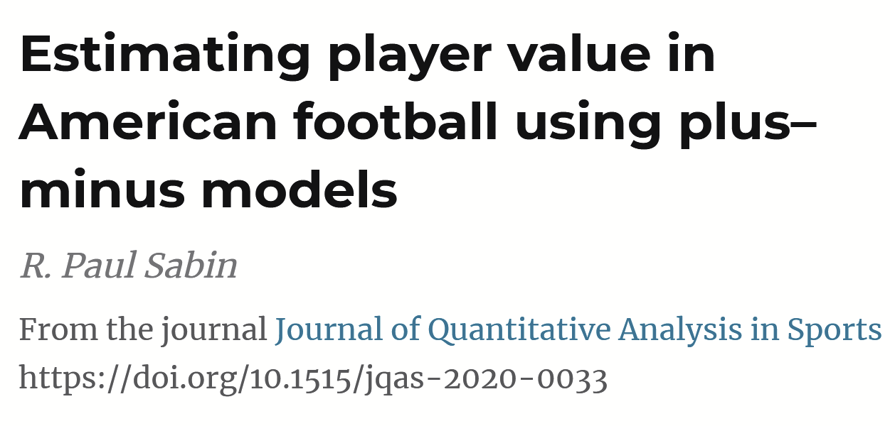
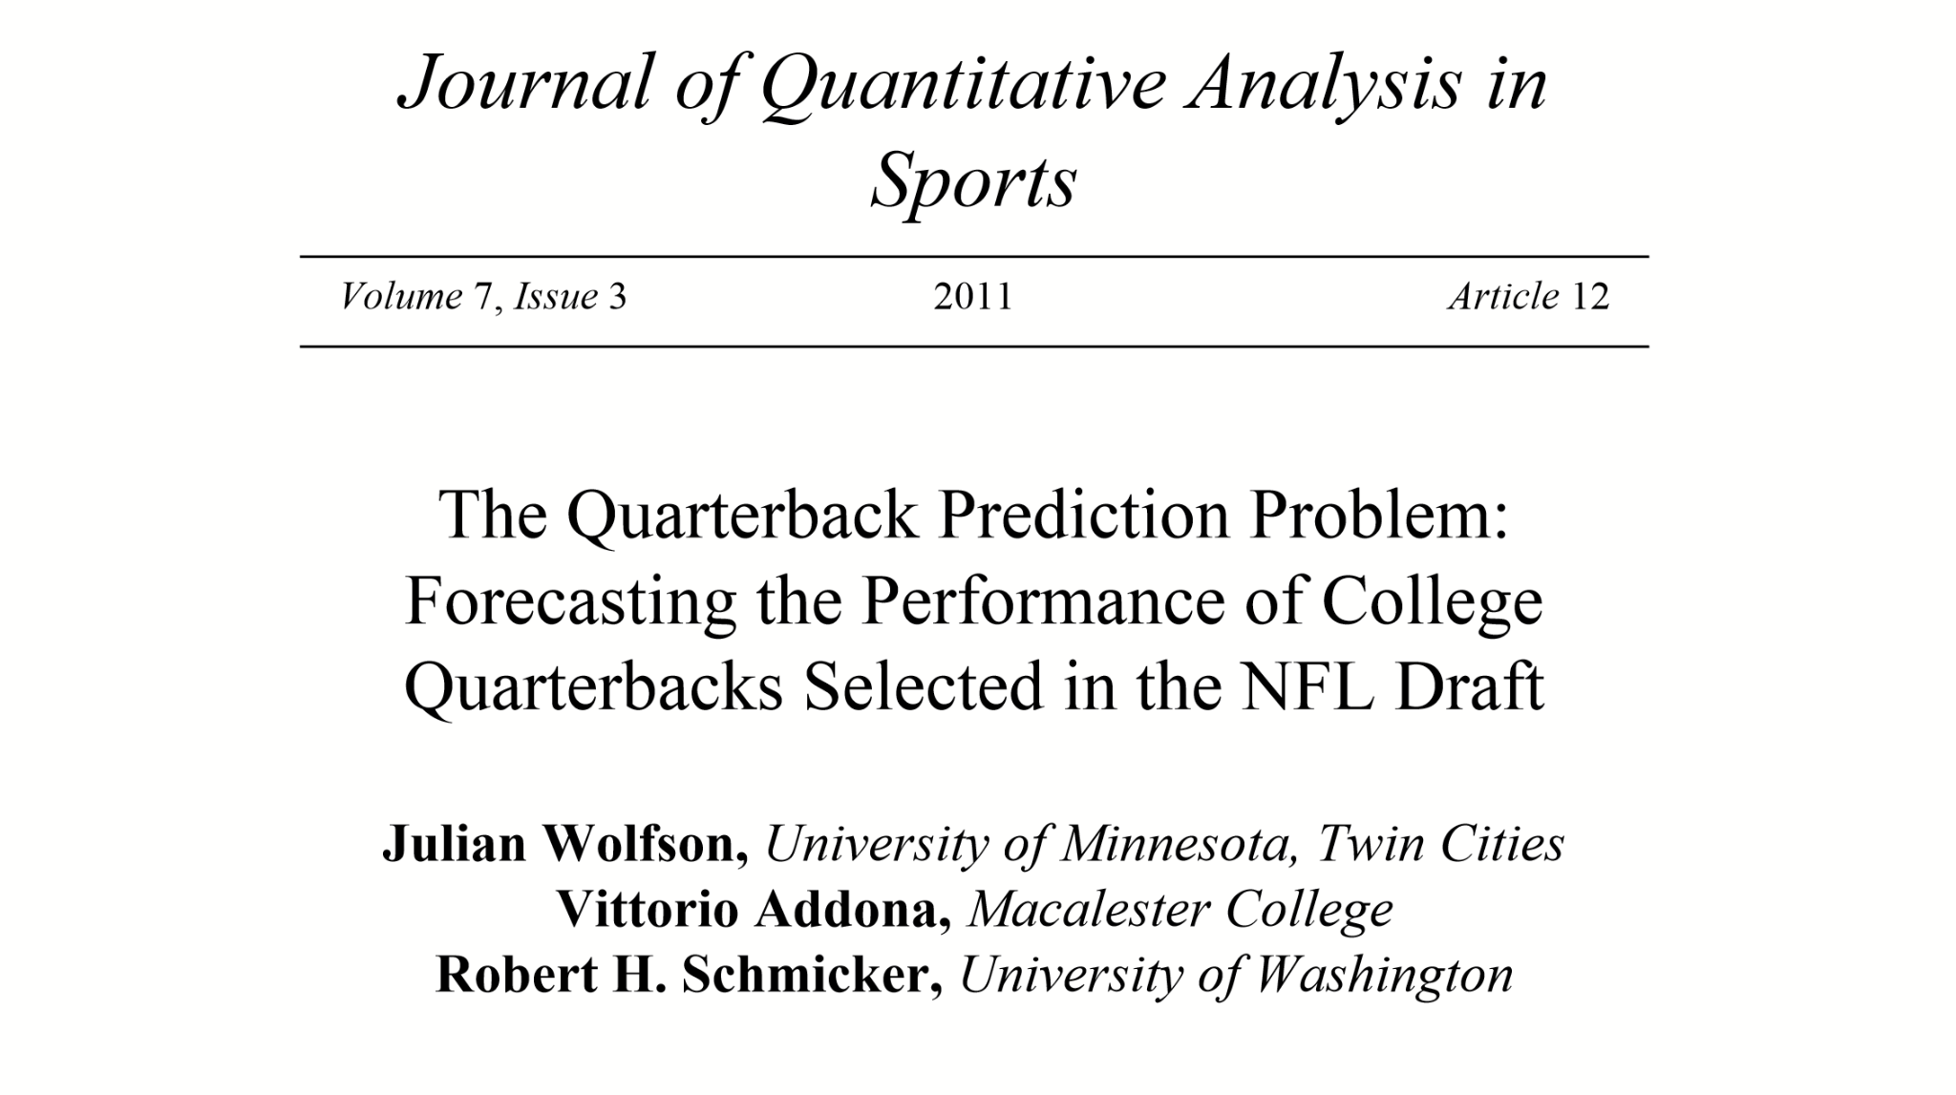
Academic Literature
4

Slide 5
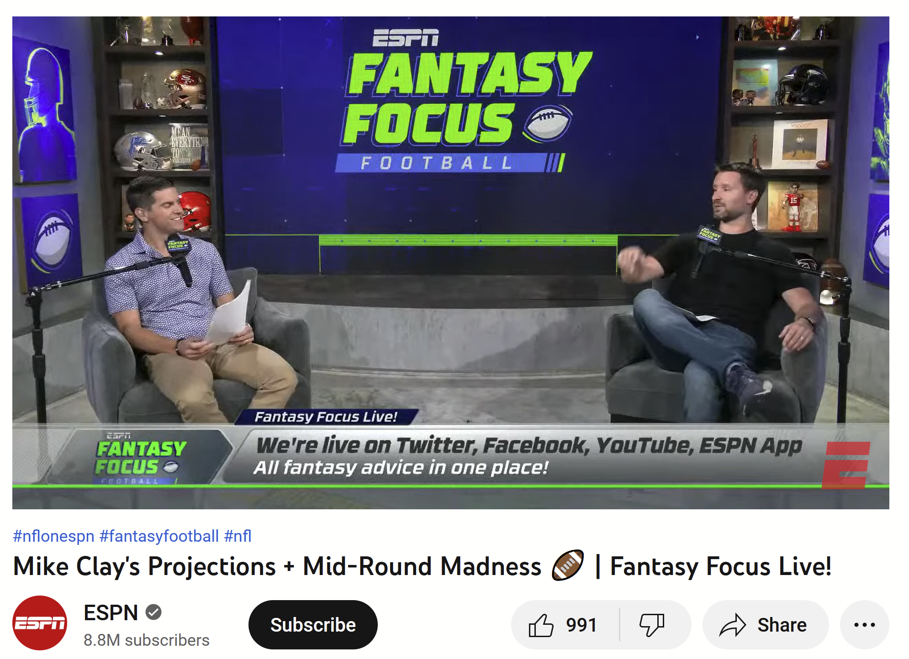
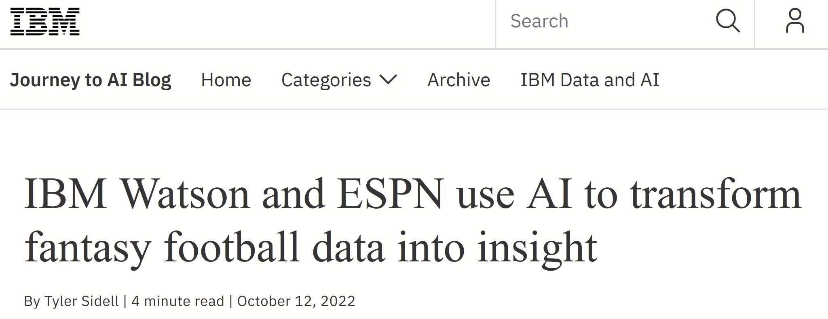
Commercial Literature
5

Slide 6
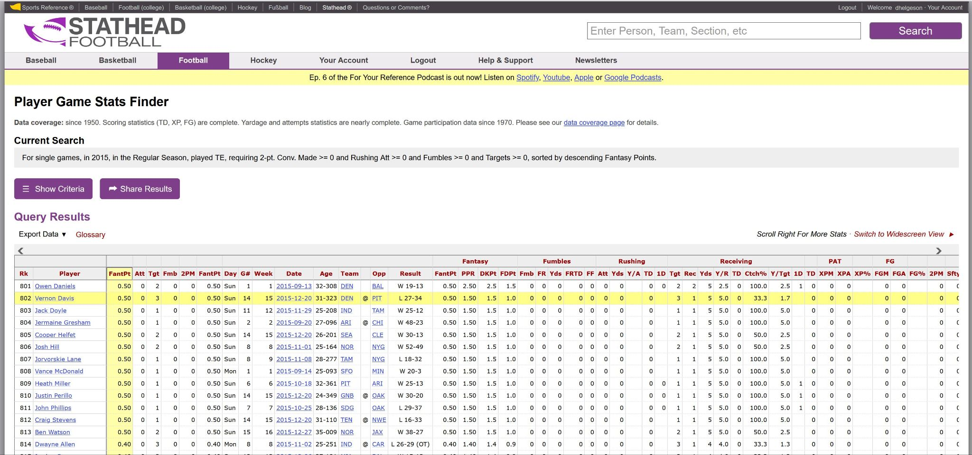
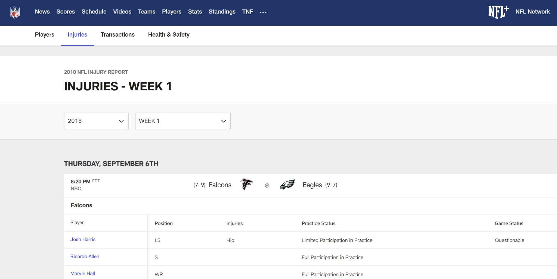
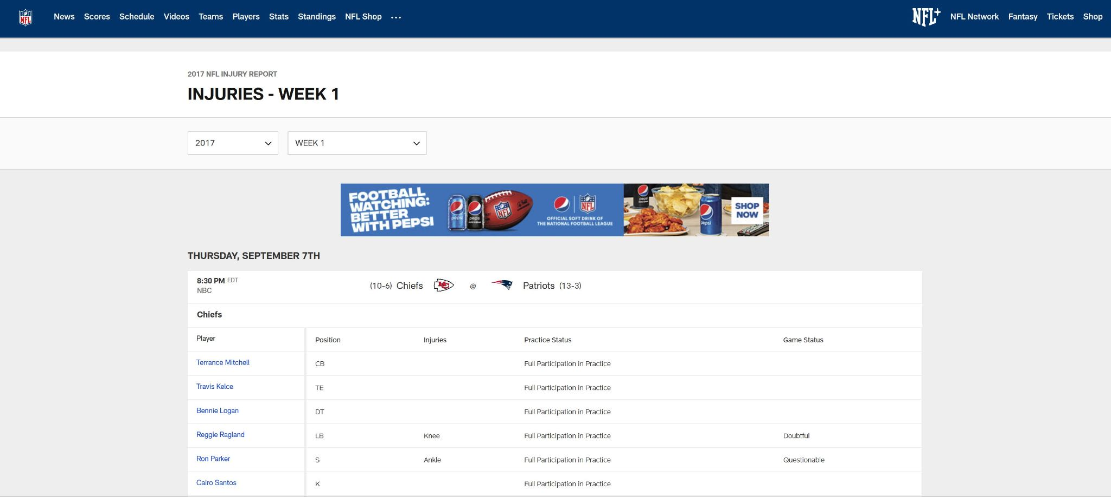
Data Source
StatHead.com
NFL.com
6

Slide 7
Data Pre-Processing
Standardizing Team Names
Substituting 0’s for missing rates
Grouping injury types
Cleaning date formatting
Exclude games with less than
5 pass attempts (Quarterbacks only)
7

Slide 8

Feature Engineering
Extract the month from date
Extract the points scored by each team and game result
Shift data so that past performance is in line with future game characteristics and fantasy points scored
Calculate moving and cumulative averages of each player’s past performance stats
Treat k as a tuning parameter
Get averages of performance against opponent
Join injury data to player-game data
8

Slide 9
Recipe
Remove near zero variance columns
Remove correlated predictors
Remove columns that were linear combinations of one another
Center & scale continuous variables
Fit natural cubic splines on numeric predictors with 3 degrees of freedom (regression only)
Create dummy columns for categorical variables (regression only)
One-hot encode categorical variables (ML only)
9

Slide 10
Modeling Frameworks
Select optimal K and retrain models using training and validation data
Tune K on Linear Regression using training-validation split
Training-Validation-Test
Split
Models & Tuning Parameters:
Base Linear Regression
Penalized Linear Regression
Penalty & mixture
Random Forest for Regression
Minimum number of observations in terminal node
Number of predictors considered at each split
XGBoost for Regression
Minimum number of observations in terminal node
Number of predictors considered at each split
Tree Depth
Learning Rate
10

Slide 11
Modeling Frameworks
Separate models for
Quarterbacks
Running Backs, Wide Receivers and Tight Ends
5-Fold cross validation repeated 5 times
11

Slide 12
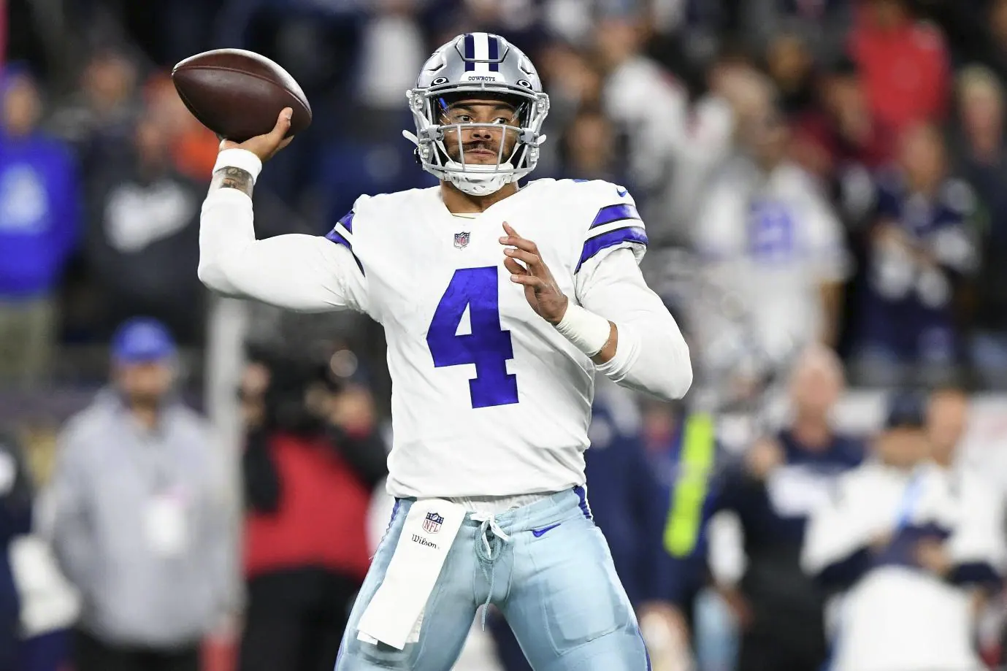
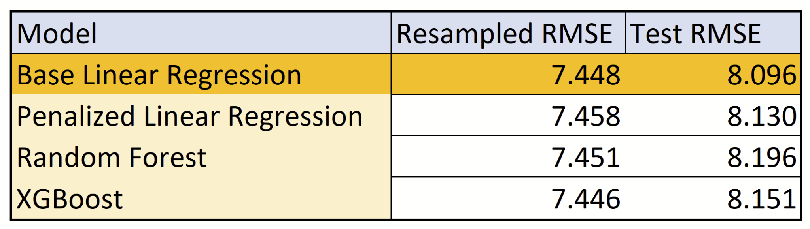
Model Performance: Quarterbacks
12

Slide 13
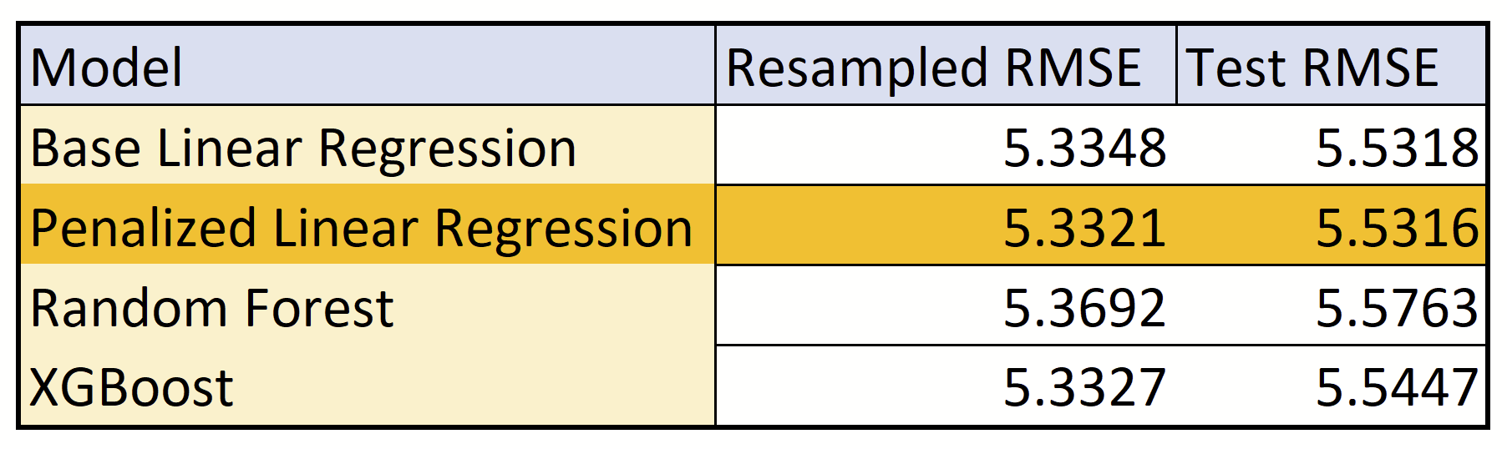
Model Performance: Running Backs, Wide Receivers, and Tight Ends
13

Slide 14
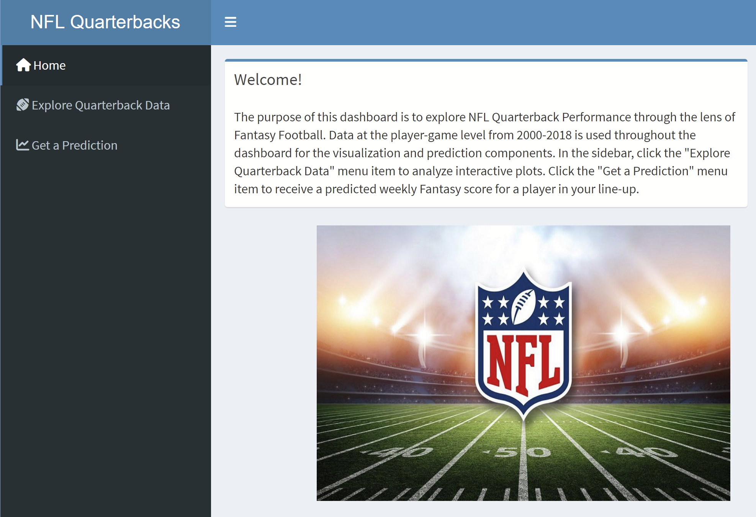
Shiny App
Explore Tab
Consumers can use the interactive visualizations to explore the relationship between Fantasy Points and other factors, such as type of injury, performance history, and team.
Useful for high level overviews
Predictions Tab
Consumers can enter information about a player of interest and receive a projected fantasy score in return.
Used on a weekly basis to make decisions about player line-up
14

Slide 15
Limitations
Future Work
Training-Validation-Test splits were not proportional for Quarterbacks and Running Backs/Wide Receivers/Tight Ends
Injury data was sparse prior to 2008
Tune for a wider range of K
Tune number of knots on natural cubic splines
Gather more data for RB, WR, & TE
15

Slide 16
Takeaways
Simple > Complex
Strong indicators of performance:
Player’s performance history
Track record of opponent
Home or Away
16

Slide 17
Literature Citations
ESPN. (2022, August 31). Mike Clay's Projections + Mid-Round Madness [Video]. YouTube.
https://www.youtube.com/watch?app=desktop&v=0aluQ44GsNM
Sabin, R. (2021). Estimating player value in American football using plus–minus models.
Journal of Quantitative Analysis in Sports, 17(4), 313-364. https://doi.org/10.1515/jqas-2020-0033
Sidell, T. (2022, October 24). IBM Watson and ESPN use AI to Transform Fantasy Football Data. Journey to AI Blog. Retrieved December 1, 2022, from https://www.ibm.com/blogs/journey-to-ai/2022/10/ibm-
watson-and-espn-use-ai- to-transform-fantasy-football-data-into-insight/
Wolfson, J., Addona, V. & Schmicker, R. (2011). The Quarterback Prediction Problem: Forecasting the
Performance of College Quarterbacks Selected in the NFL Draft. Journal of Quantitative Analysis in
Sports, 7(3). https://doi.org/10.2202/1559-0410.1302
17

